Slide 1
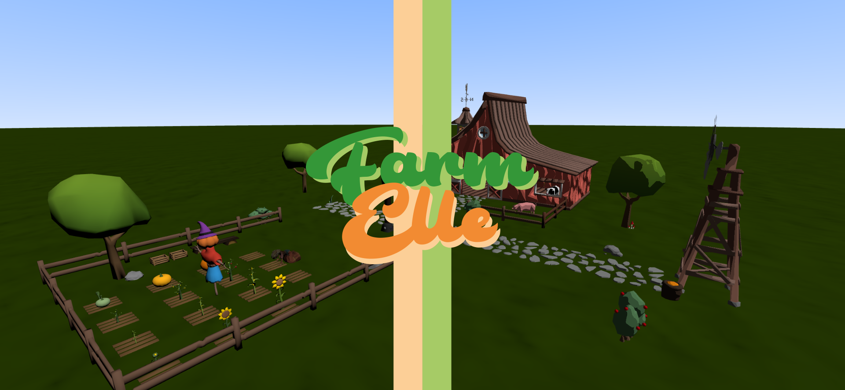

Slide 2

Precision Agriculture: Using technology to improve agricultural productivity and sustainability
In our farming practices, we've strategically combined the Knapsack Algorithm and Liebig's Minimum Law to enhance efficiency and sustainability. Through this integrated approach, our goal is to achieve precision in resource utilization, minimizing waste while maximizing crop yield. Leveraging the computational efficiency of the Knapsack Algorithm and the strategic insights from Liebig's Minimum Law, we aim to make informed decisions that contribute to both increased agricultural productivity and environmentally conscious farming practices.

Slide 3
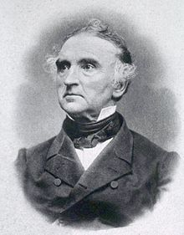
Liebig's Minimum Law
Justus von Liebig's Minimum Law, a fundamental principle in resource optimization, asserts that the growth or output of a system is determined by its scarcest resource. In other words, the limiting factor, or the resource in minimum supply, constrains overall performance. This concept, named after chemist Justus von Liebig, is crucial in various fields, emphasizing the importance of addressing and optimizing the most limiting resource to achieve maximum efficiency.

Slide 4
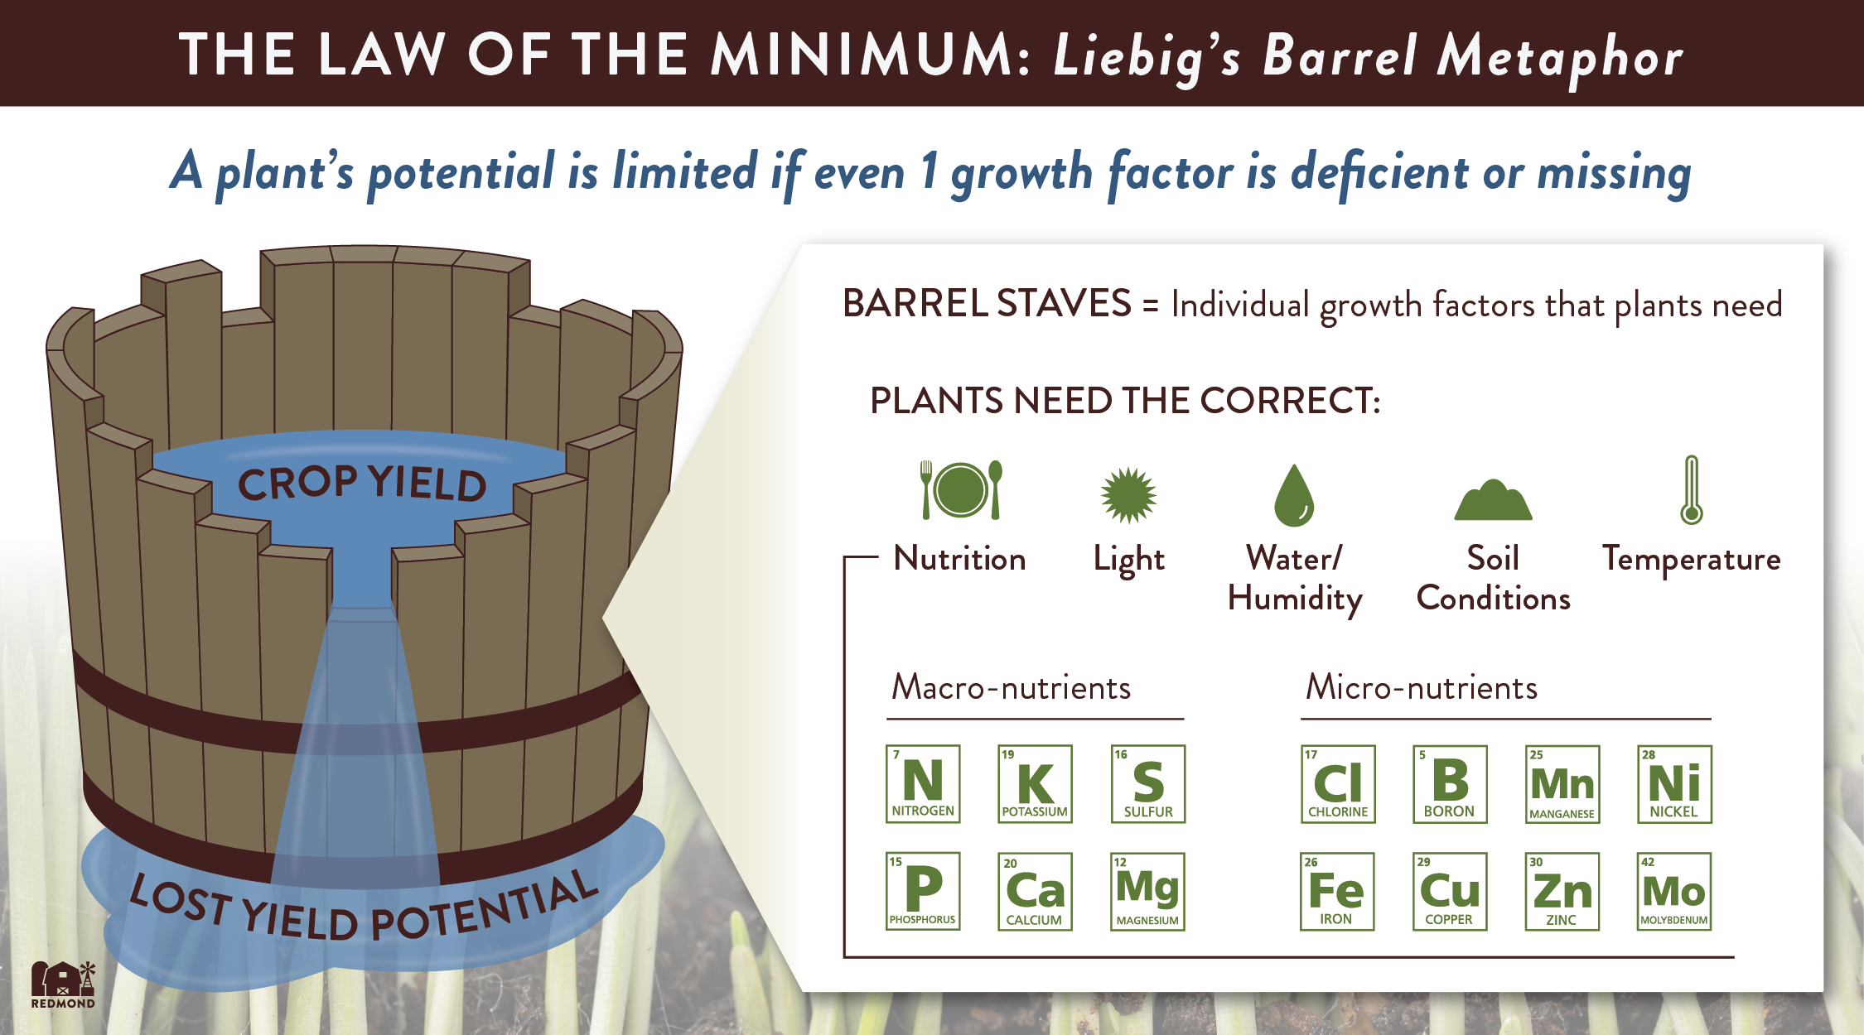

Slide 5
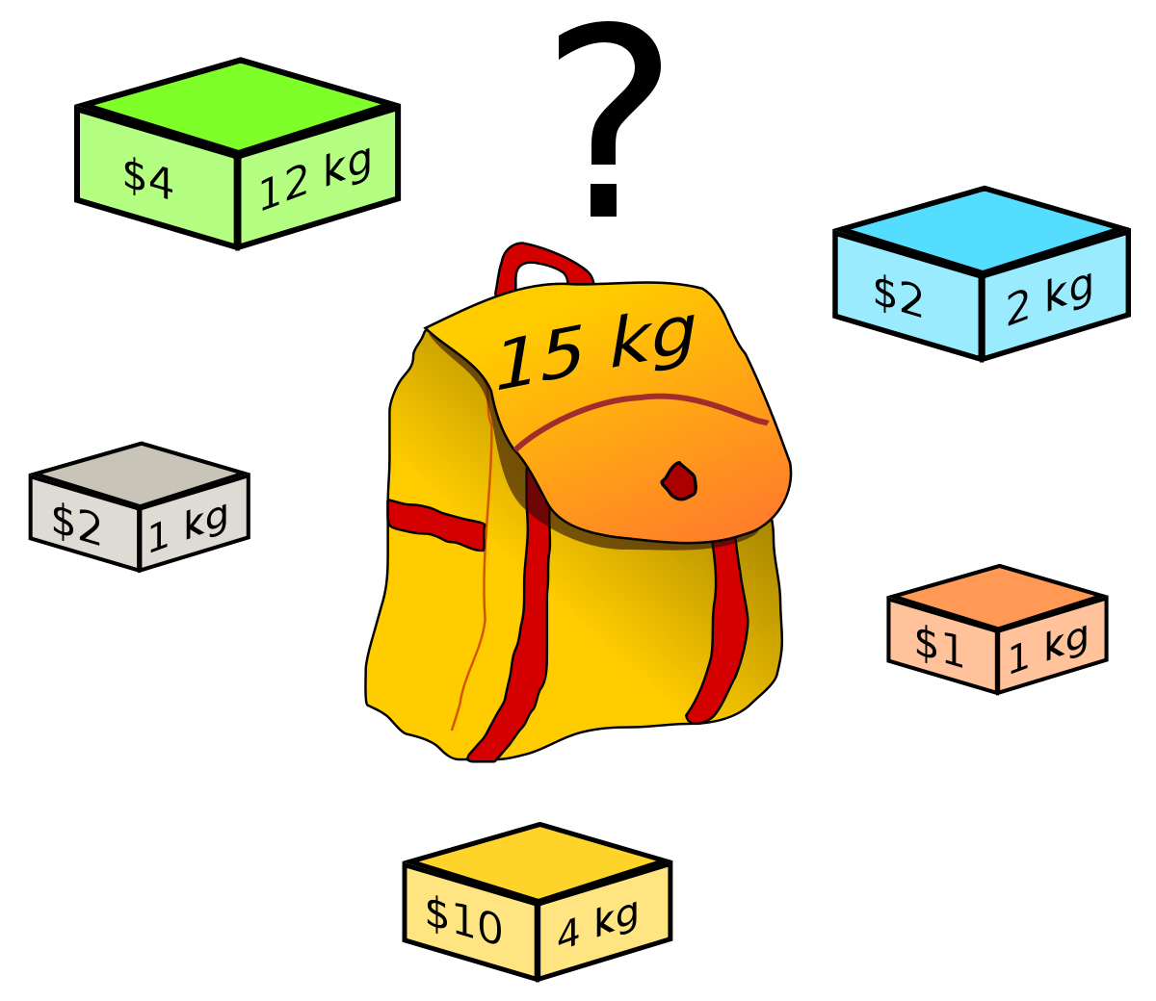
Knapsack Algorithm
The knapsack algorithm is a dynamic programming tool used for optimizing resource allocation, specifically when items have values and weights, and there's a constraint on the total weight that can be carried. It's widely applied in scenarios like resource management.

Slide 6
Connection Between Knapsack and Liebig
The connection between the Knapsack Algorithm and Liebig's Minimum Law lies in their shared emphasis on optimizing resource utilization. The Knapsack Algorithm, a dynamic programming technique, addresses computational problems by efficiently allocating items with weights and values within specified constraints. In parallel, Liebig's Minimum Law asserts that the growth or output of a system is constrained by its scarcest resource, urging a focus on optimizing limiting factors for optimal overall performance.

Slide 7
SHADERS
Phong Shading
Toon Shading

Slide 8
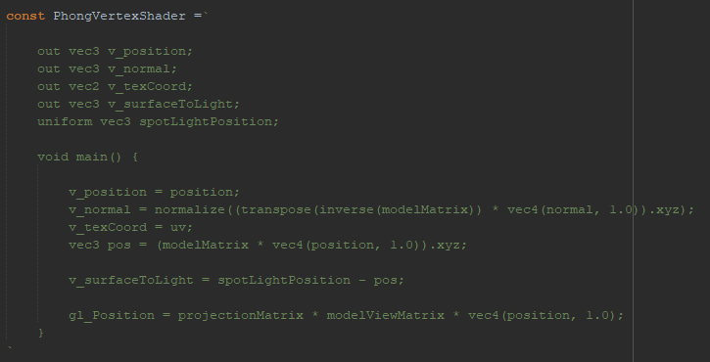

Slide 9
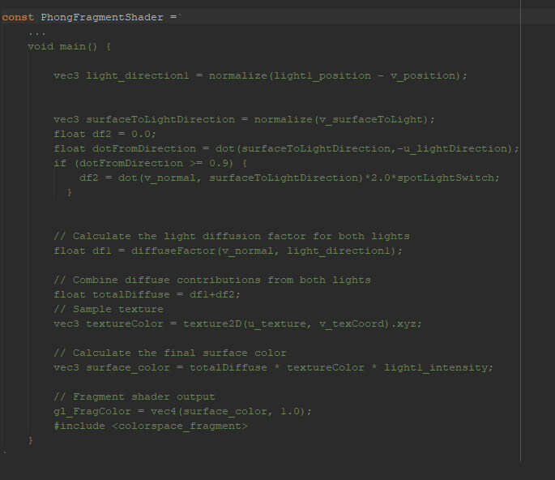

Slide 10
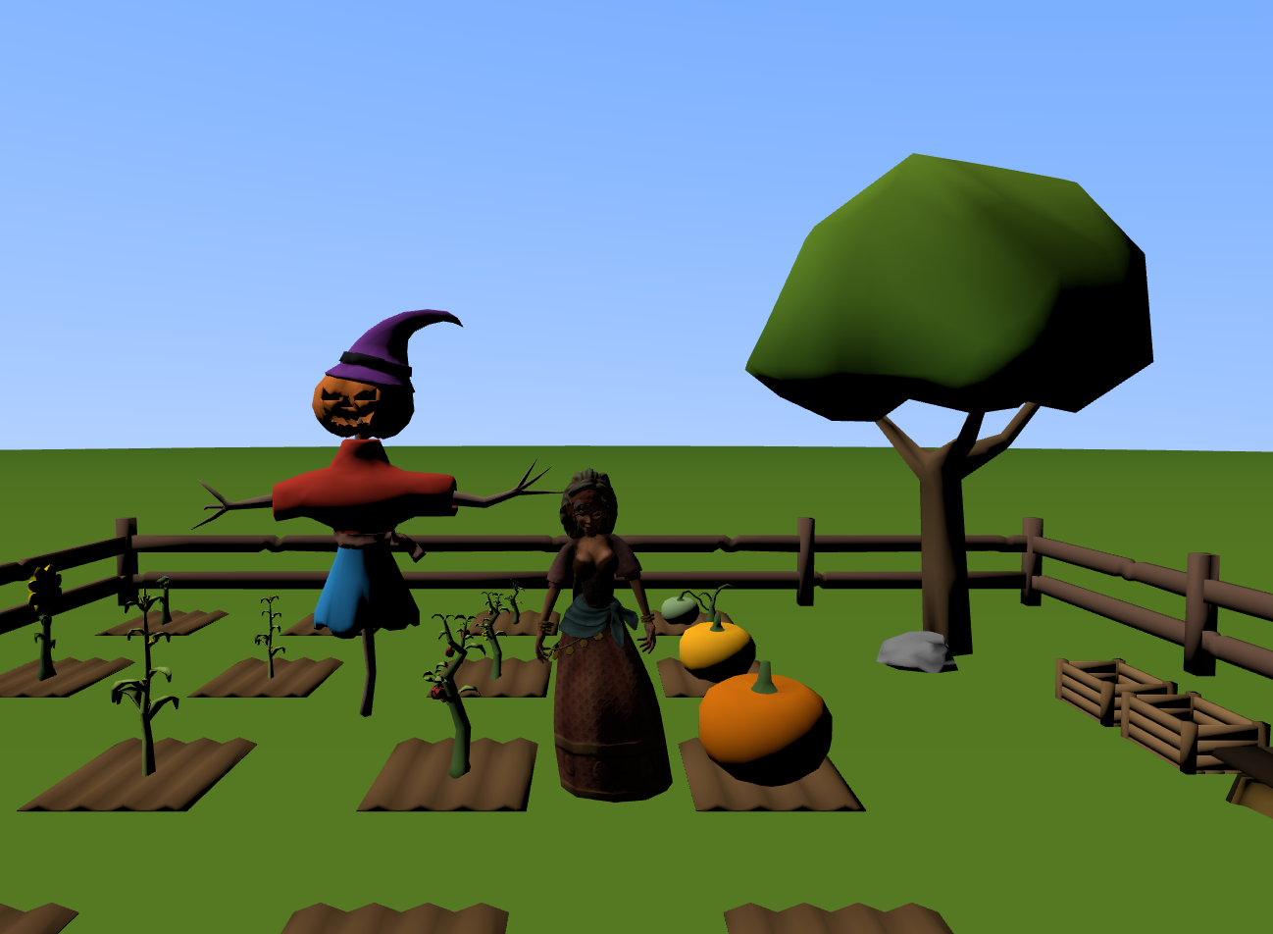

Slide 11
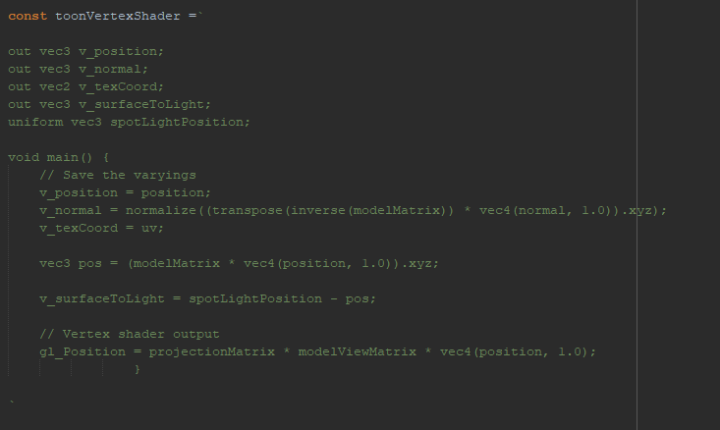

Slide 12
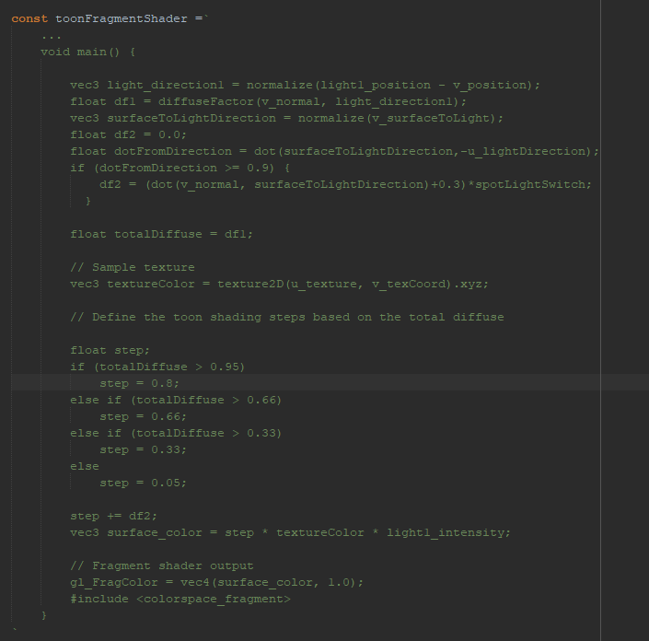

Slide 13
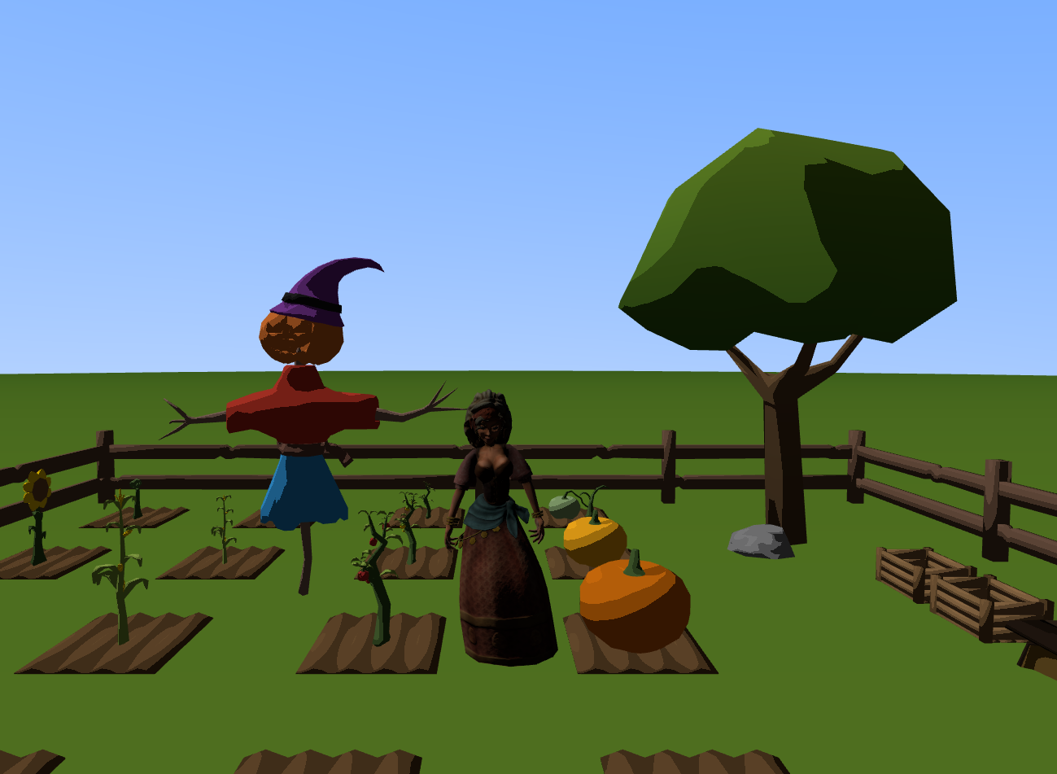

Slide 14
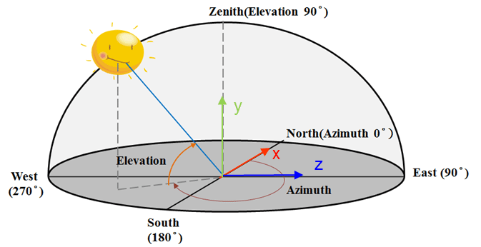
Implementation of Day and Night Cycle

Slide 15
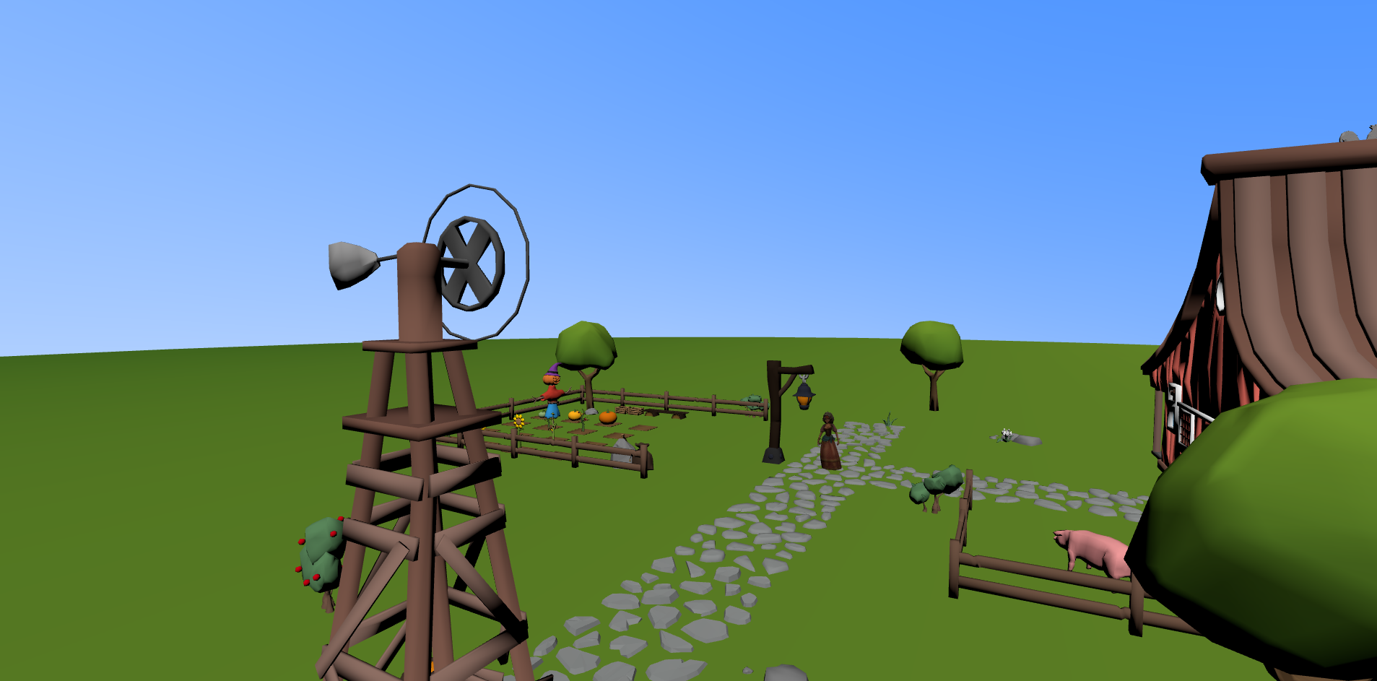

Slide 16
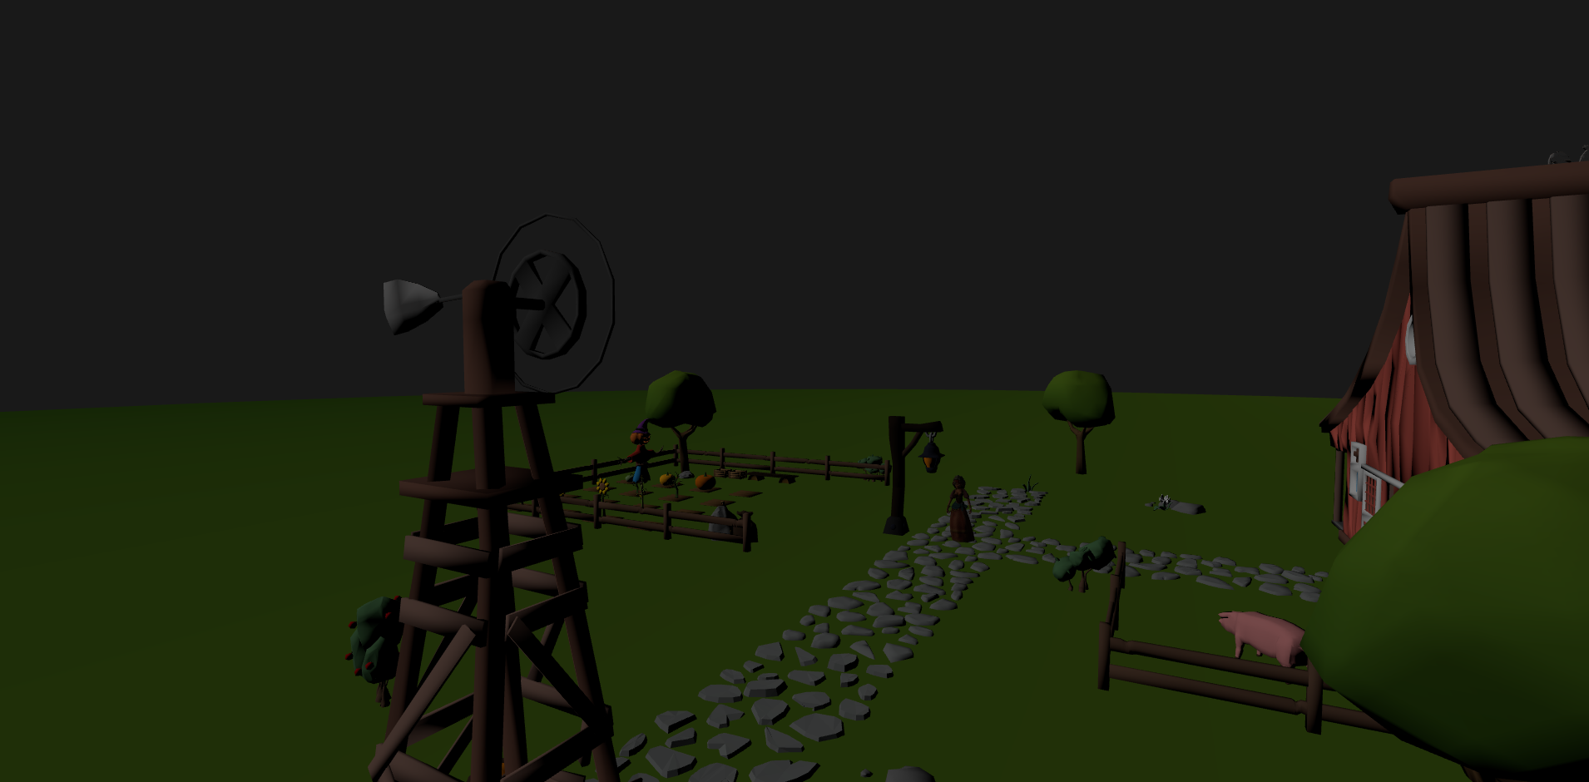

Slide 17
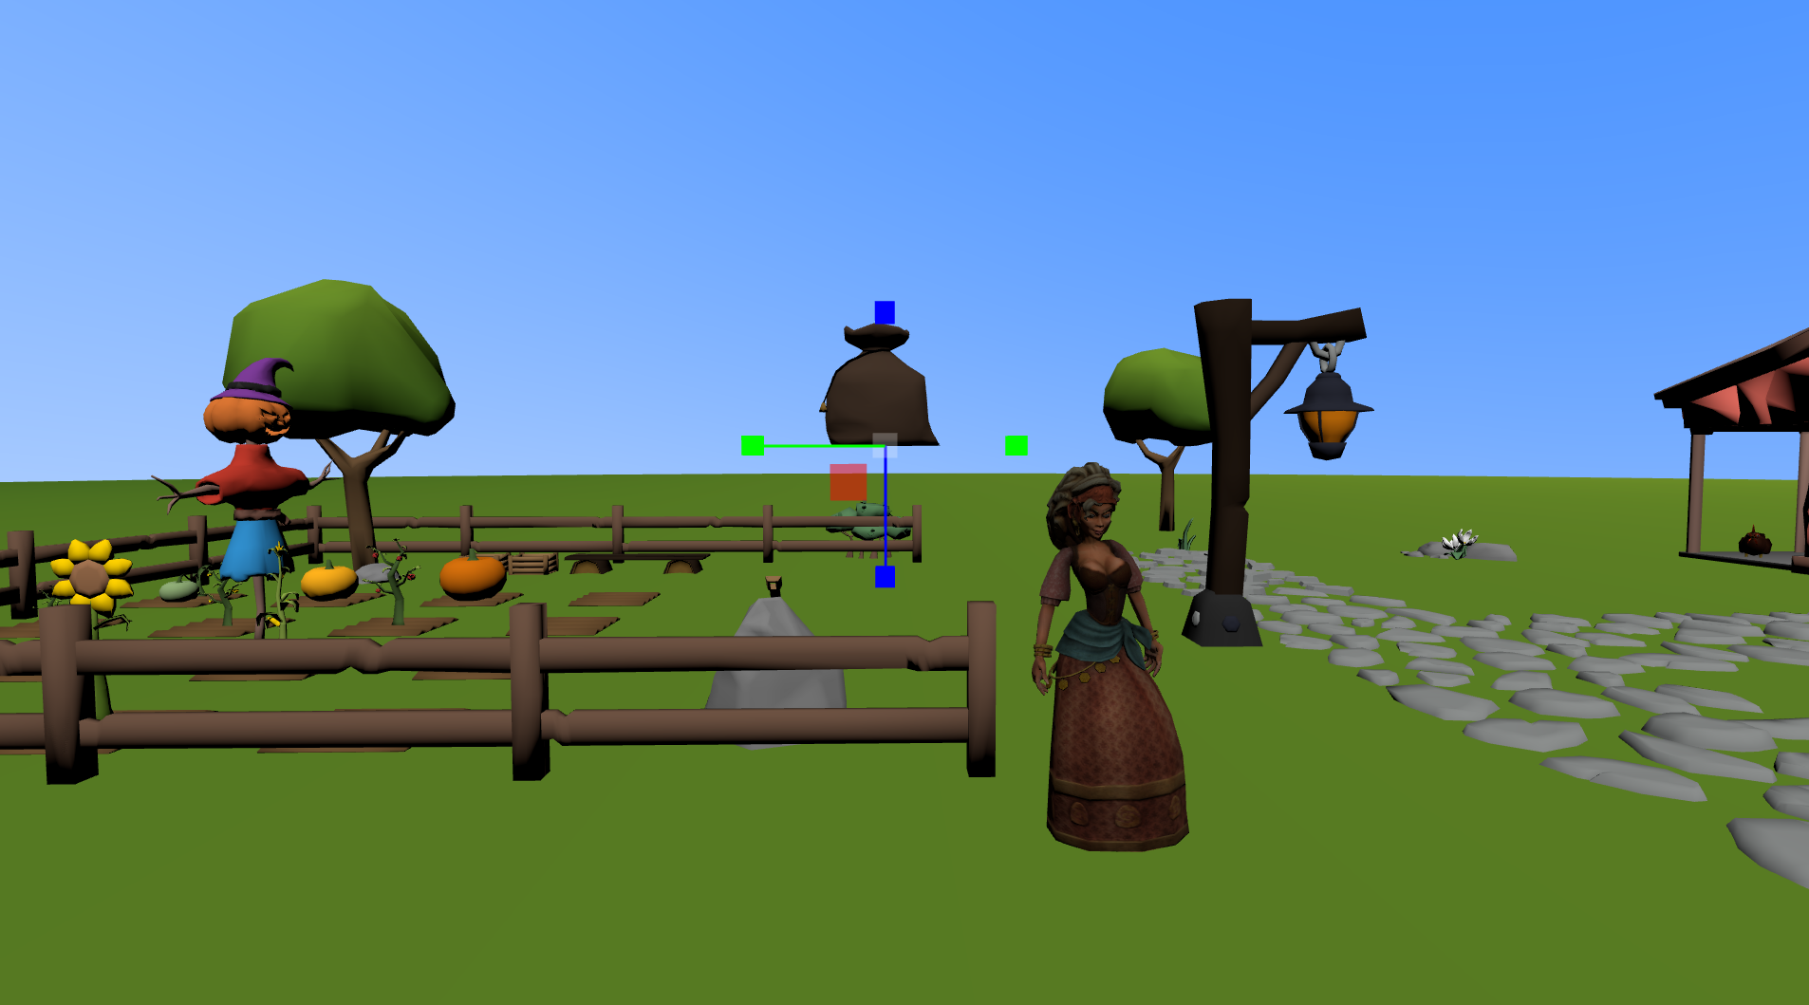
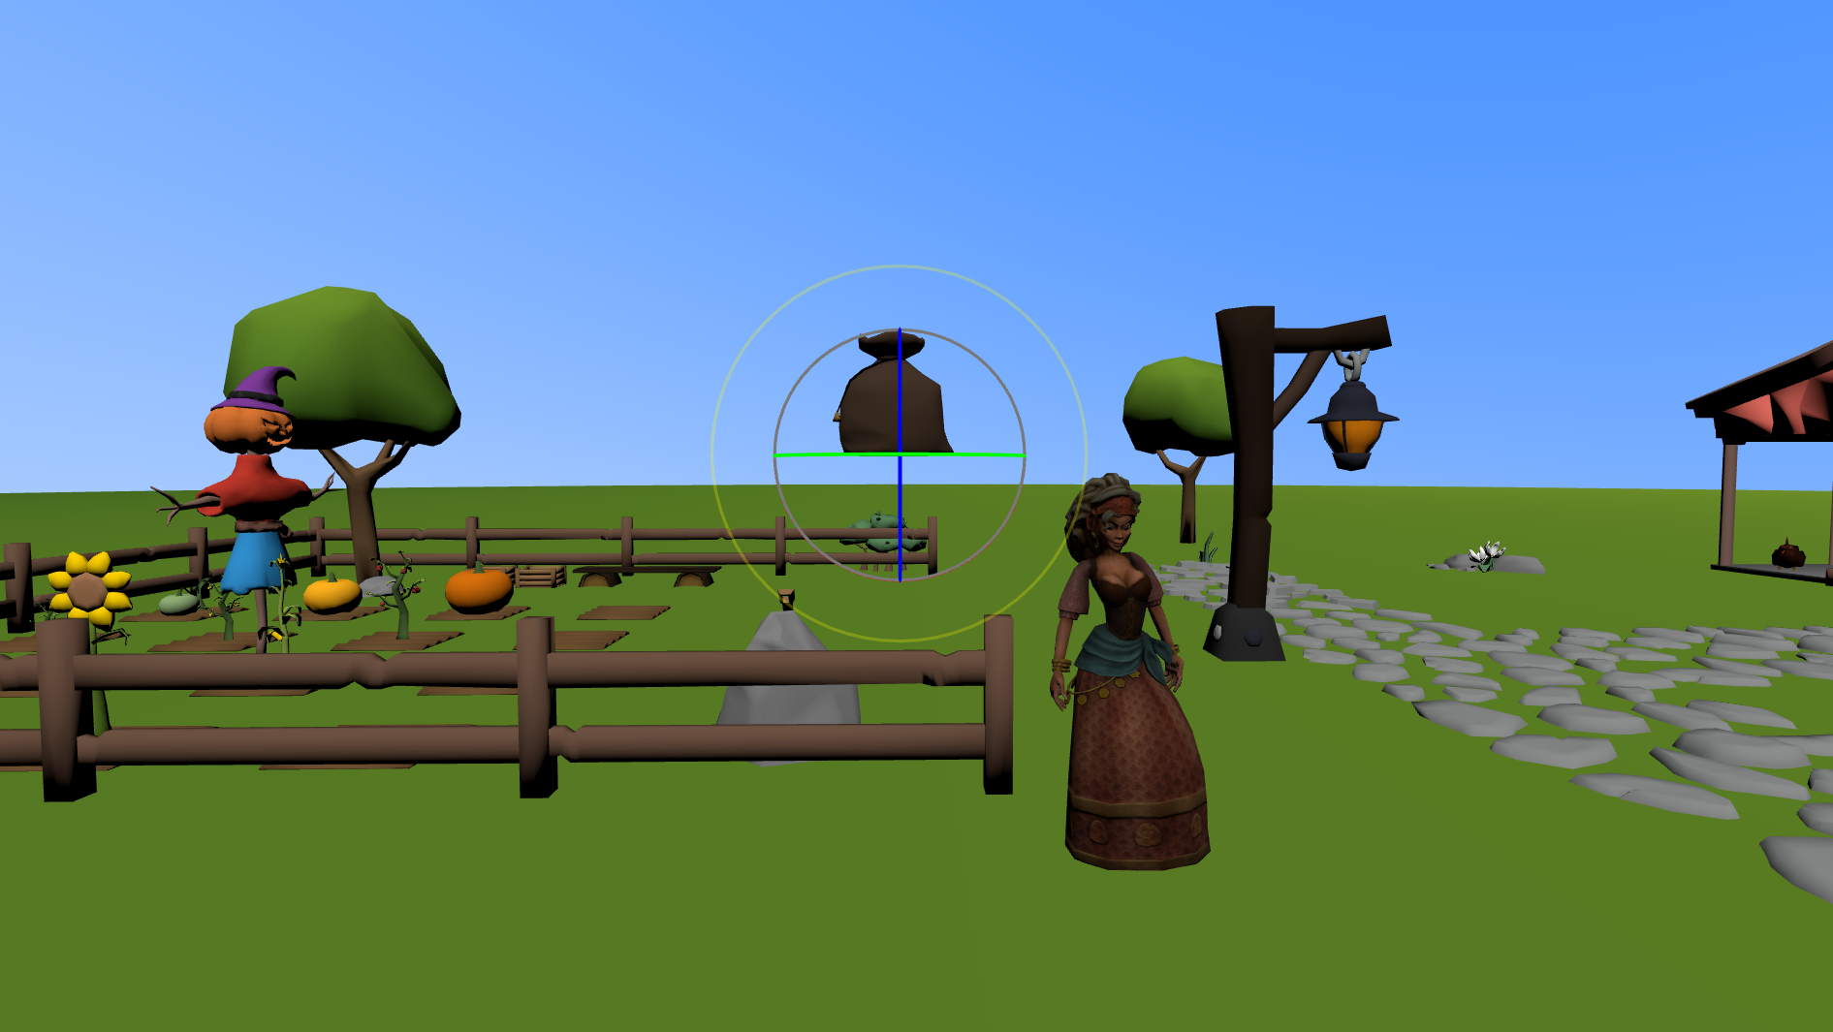
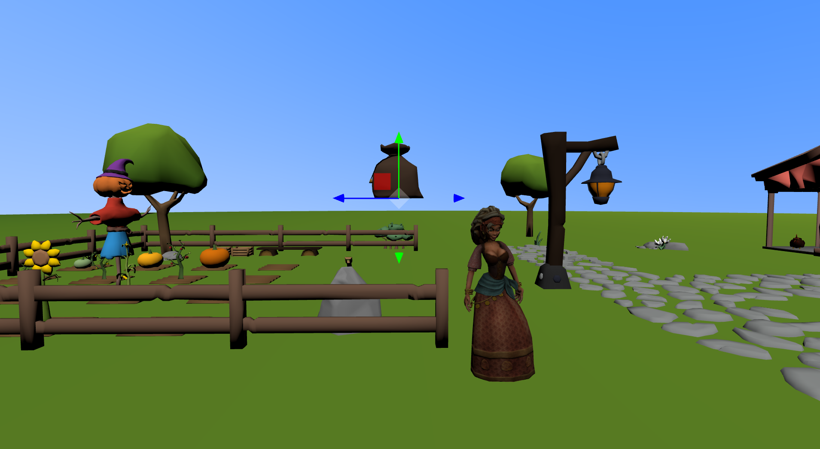
Translate mode
Scale mode
Rotate mode

Slide 18
Project Team
Alperen Akça 2200356035 Murat Günay 2200356040
Murat Eren Aytekin 2200356026
Yusuf Karataş 2200356022
Thank you!

